Slide 1
PROTOCOLS AND STANDARDS

Slide 2
PROTOCOLS AND STANDARDS
In this section, we define two widely used terms: protocol and standards.
First, we define protocol, which is synonymous with rule.
Second, we discuss standards, which are agreed-upon rules.

Slide 3
PROTOCOLS
Protocol are used for communication between computers in different computer networks. Protocol achieves:
What is communicated between computers?
How it is communicated?
When it is communicated?
What conformance (bit sequence) between computers?
Key elements of a protocol are:
SYNTAX: Data format and signal levels
SEMANTICS: Control information for coordination and error handling
TIMING: Synchronization, speed matching, and sequencing
Examples of protocols:
WAN Protocol: TCP/IP
LAN Protocol: Media Access Control; Contention; Token Passing

Slide 4
Standards
Standards are essential in creating and maintaining an open and competitive market for equipment manufacturers
Required to guarantee national and international interoperability of data and telecommunications technology and processes
Categories of data communications standards:
—De facto: Standards that have not been approved by an organizational body but have been adopted through widespread use, eg. model TCP/IP)
—De jure: Those that have been legislated by an official recognized body, eg. OSI model

Slide 5
Standards Organization
Standards creation committees
— ISO (International Organization for Standardization)
— ITU-T (International Telecommunications Union - Telecommunications Standards)
Initially known as CCITT (Consultative Committee for International Telegraphy and Telephony)
— ANSI (American National Standards Institute)
— IEEE (Institute of Electrical and Electronics Engineers) — EIA (Electronic Industries Association)
Forums
— Made up of representatives from interested corporations to speed acceptance and use of new technologies in the telecom industry
Regulatory Agencies
— Governmental agencies: to protect public interest by regulating radio, TV and wire/cable communications

Slide 6
NETWORK MODEL

Slide 7
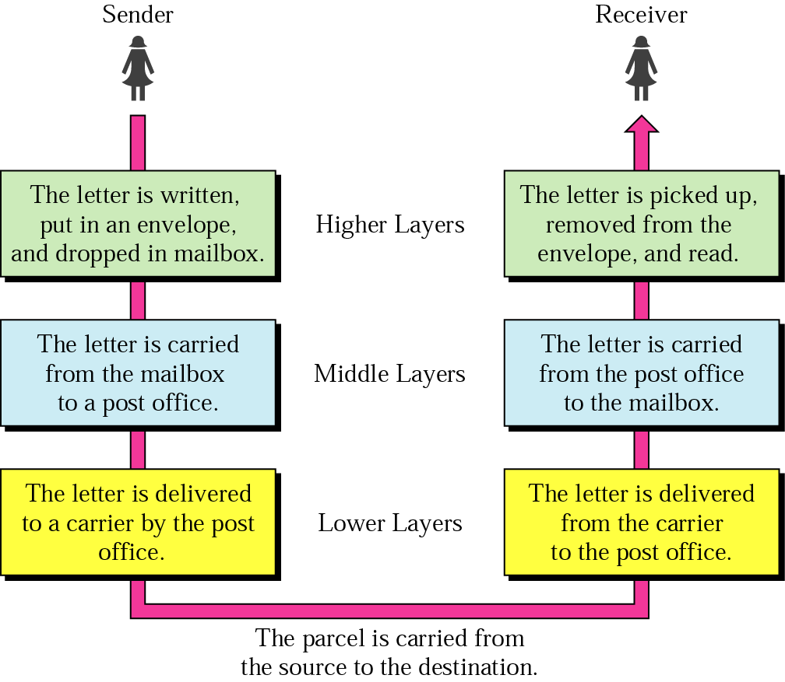
Task Involved in Sending a Letter

Slide 8
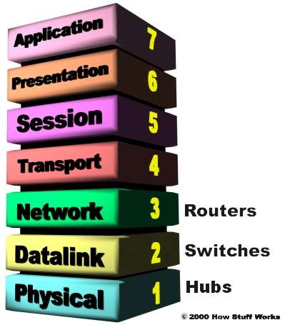
ISO/OSI Reference Model

Slide 9
Organization of the Layers
The seven layers can be thought of as belonging to three subgroups.
Layers 1, 2, and 3-physical, data link, and network-are the network support layers
They deal with the physical aspects of moving data from one device to another
such as electrical specifications, physical connections, physical addressing, and transport timing and reliability

Slide 10
Organization of the Layers
Layers 5, 6, and 7-session, presentation, and application-can be thought of as the user support layers
They allow interoperability among unrelated software systems.
Layer 4, the transport layer, links the two subgroups and ensures that what the lower layers have transmitted is in a form that the upper layers can use.

Slide 11
Organization of the Layers
The process starts at layer 7 (the application layer), then moves from layer to layer in descending, sequential order.
At each layer, a header, or possibly a trailer, can be added to the data unit.
Commonly, the trailer is added only at layer 2.
When the formatted data unit passes through the physical layer (layer 1), it is changed into an electromagnetic signal and transported along a physical link.

Slide 12
Encapsulation
The data portion of a packet at level N - 1 carries the whole packet (data and header and maybe trailer) from level N.
The concept is called encapsulation;
level N - 1 is not aware of which part of the encapsulated packet is data and which part is the header or trailer.
For level N - 1, the whole packet coming from level N is treated as one integral unit.

Slide 13
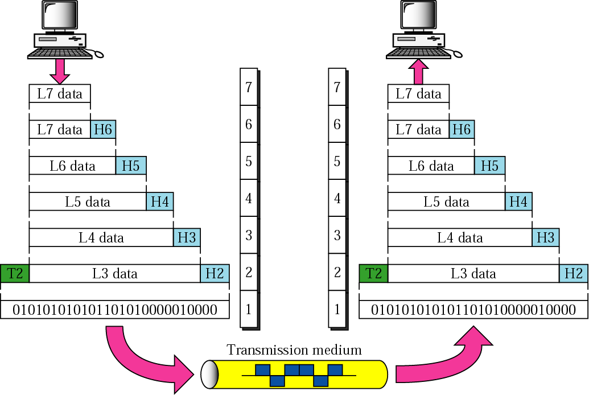
Protocol Reference Model of OSI
OSI Overview
Data Encapsulation
a) Protocol Data Unit (PDU) conception – each protocol on the diff. layer has its own format.
b) Headers are added while a packet is going down the stack at each layer.
c) Trailers are usually added on the second layer.

Slide 14
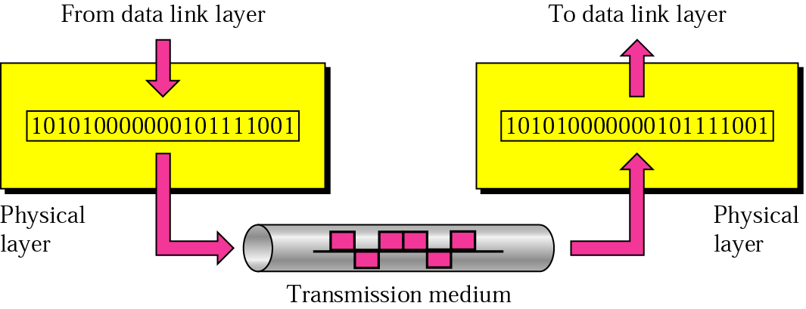
Physical Layer
Note:
The physical layer is responsible for transmitting individual bits from one node to the next.

Slide 15
Physical Layer
The physical layer coordinates the functions required to transmit a bit stream over a physical medium.
It also defines the procedures and functions that physical devices and interfaces have to perform for transmission occur.

Slide 16
Physical layer
The physical layer is concerned with the following:
Physical characteristics of interfaces and media: The physical layer defines the characteristics of the interface between devices and the transmission media, including its type.
Representation of the bits: the physical layer data consist of a stream of bits without any interpretation. To be transmitted, bits must be encoded into signals –electrical or optical-. The physical layer defines the type of encoding.
Data rate: The physical layer defines the transmission rate, the number of bits sent each second.

Slide 17
Physical Layer
Line configuration: the physical layer is concerned with the connection of devices to the medium.
Physical topology
Transmission Mode

Slide 18
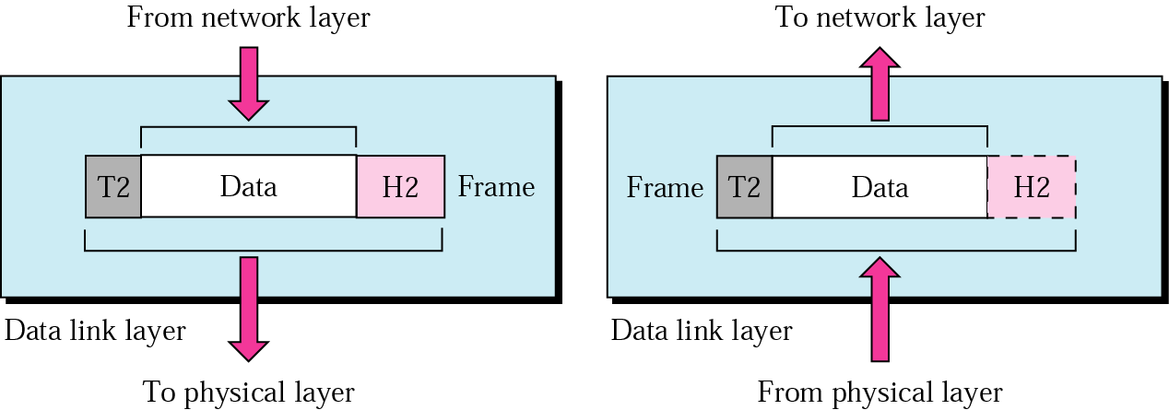
Data Link Layer
Note:
The data link layer is responsible for transmitting frames from one node to the next.

Slide 19
Data Link Layer
The data link layer transforms the physical layer, a raw transmission facility, to a reliable link and is responsible for node-to-node delivery.
It makes the physical layer appear error free to the upper layer (network layer).

Slide 20
Functions of the data link layer:
Framing. The data link layer divides the stream of bits received from the network layer into data units called frames.
Physical addressing. If frames are to be distributed to different systems on the network, the data link layer adds a header to the frame to define the physical address of the sender (source address) and/or receiver (destination address) of the frame.
If the frame is intended for a system outside the sender’s network, the receiver address is the address of the device that connects one network to the next.

Slide 21
Flow Control. If the rate at which the data are absorbed by the receiver is less than the rate produced in the sender, the data link layer imposes a flow control mechanism to prevent overwhelming the receiver.
Error control. The data link layer adds reliability to the physical layer by adding mechanisms to detect and retransmit damaged or lost frames. Error control is normally achieved through a trailer to the end of the frame.
Access Control. When two or more devices are connected to the same link, data link layer protocols are necessary to determine which device has control over the link at any time.

Slide 22
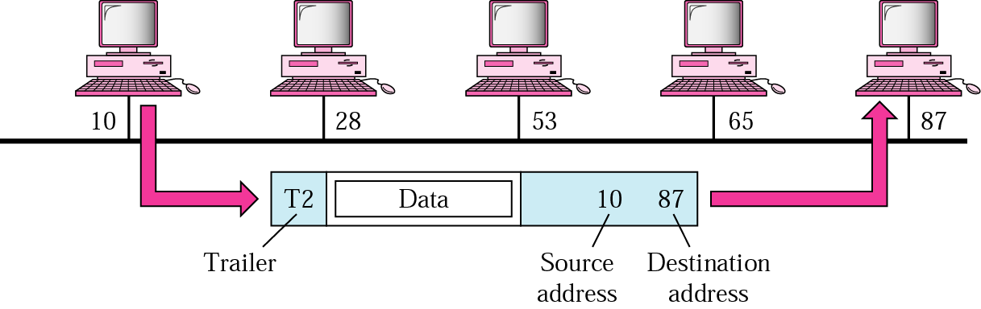

Slide 23
Example 1
In Figure a node with physical address 10 sends a frame to a node with physical address 87. The two nodes are connected by a link. At the data link level this frame contains physical addresses in the header. These are the only addresses needed. The rest of the header contains other information needed at this level. The trailer usually contains extra bits needed for error detection

Slide 24
Example 1 Figure

Slide 25
Network Layer
The Network layer is responsible for the source-to-destination delivery of a packet possible across multiple networks.
If two systems are connected to the same link, there is usually no need for a network layer. However, if the two systems are attached to different networks, there is often a need for the network layer to accomplish source-to-destination delivery.

Slide 26
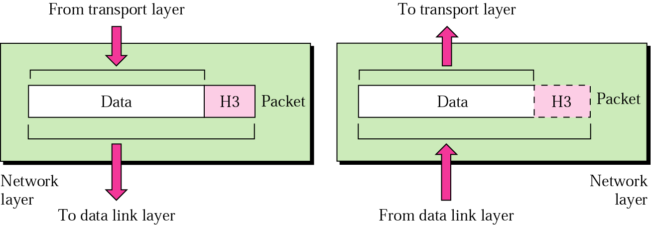
Network Layer
Functions:
Logical addressing.
Routing
The network layer is responsible for the delivery of packets from the original source to the final destination.

Slide 27
Logical addressing. The physical addressing implemented by the data link layer handles the addressing problem locally.
The network layer adds a header to the packet coming from the upper layer, among other things, includes the logical address of the sender and receiver.
Routing. When independent networks or links are connected together to create an internetwork (a network of networks) or a large network, the connecting devices (called routers or gateways) route or switch the packets to their final destination.

Slide 28
Example 2
In Figure we want to send data from a node with network address A and physical address 10, located on one LAN, to a node with a network address P and physical address 95, located on another LAN. Because the two devices are located on different networks, we cannot use physical addresses only; the physical addresses only have local jurisdiction. What we need here are universal addresses that can pass through the LAN boundaries. The network (logical) addresses have this characteristic.

Slide 29
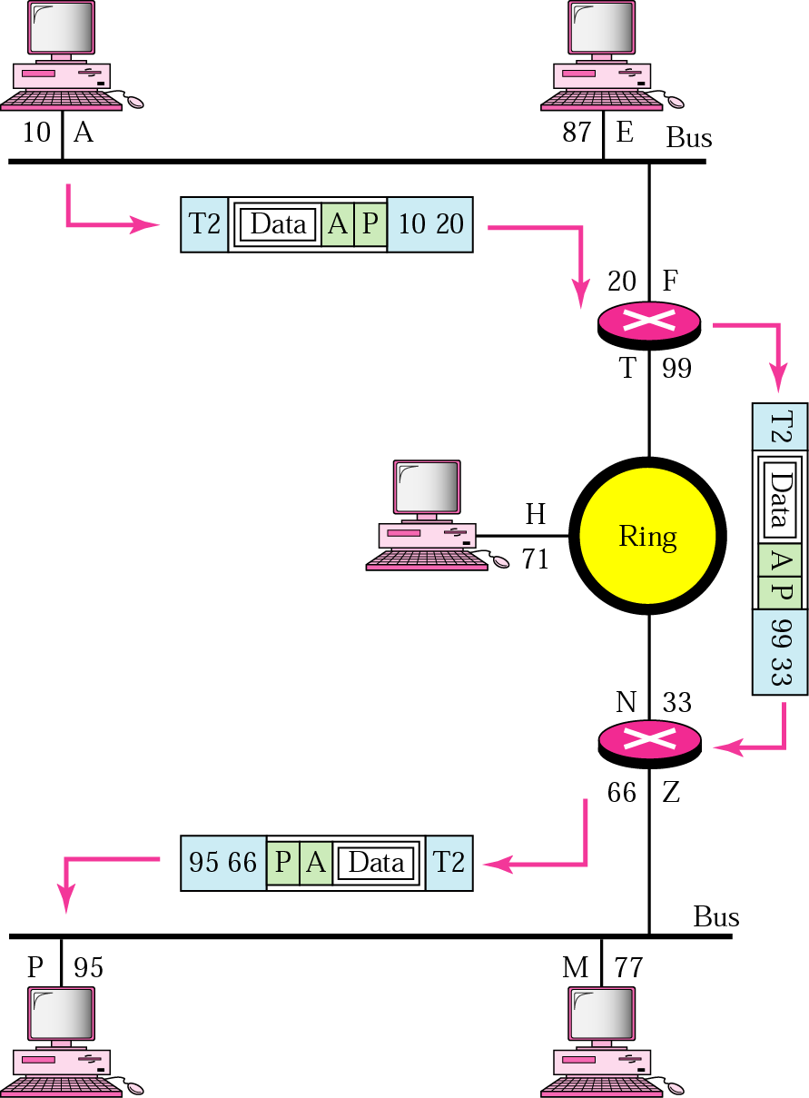
Example 2 Figure

Slide 30
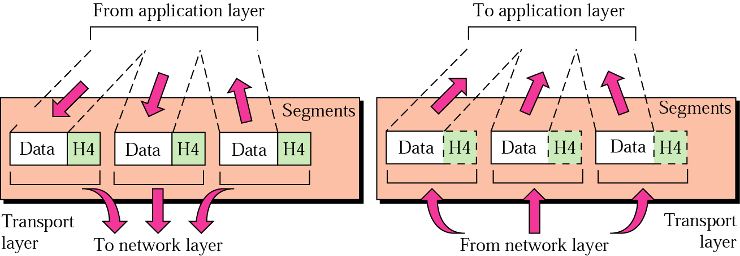
Transport Layer
Note:
The transport layer is responsible for delivery of a message from one process to another.

Slide 31
Transport Layer
The transport layer is responsible for process-to-process delivery of the entire message.
The network layer oversees host-to-destination delivery of individual packets, it does not recognize any relationship between those packets.
The transport layer ensures that the whole message arrives intact and in order, overseeing both error control and flow control at the process-to-process level.

Slide 32
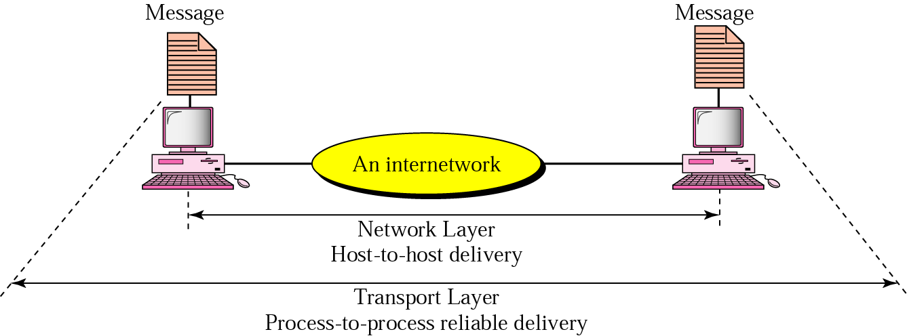
Reliable process-to-process delivery of a message

Slide 33
Functions of the transport layer
Port addressing: computer often run several processes (running programs) at the same time. Process-to-process delivery means delivery from a specific process on one computer to a specific process on the other.
The transport layer header include a type of address called port address.
The network layer gets each packet to the correct computer; the transport layer gets the entire message to the correct process on that computer.

Slide 34
Functions of the transport layer
Segmentation and reassembly: a message is divided into transmittable segments, each having a sequence number. These numbers enable the transport layer to reassemble the message correctly upon arrival at the destination.
Connection control: The transport layer can be either connectionless or connection-oriented.
A connectionless transport layer treats each segment as an independent packet and delivers it to the transport layer at the destination machine.
A connection-oriented transport layer makes a connection with the transport layer at the destination machine first before delivering the packets. After all the data are transferred, the connection is terminated.

Slide 35
Functions of the transport layer
Flow control: the transport layer performs a flow control end to end. The data link layer performs flow control across a single link.
Error control: the transport layer performs error control end to end. The data link layer performs control across a single link.

Slide 36
Example 3
Figure shows an example of transport layer communication. Data coming from the upper layers have port addresses j and k (j is the address of the sending process, and k is the address of the receiving process). Since the data size is larger than the network layer can handle, the data are split into two packets, each packet retaining the port addresses (j and k). Then in the network layer, network addresses (A and P) are added to each packet.

Slide 37
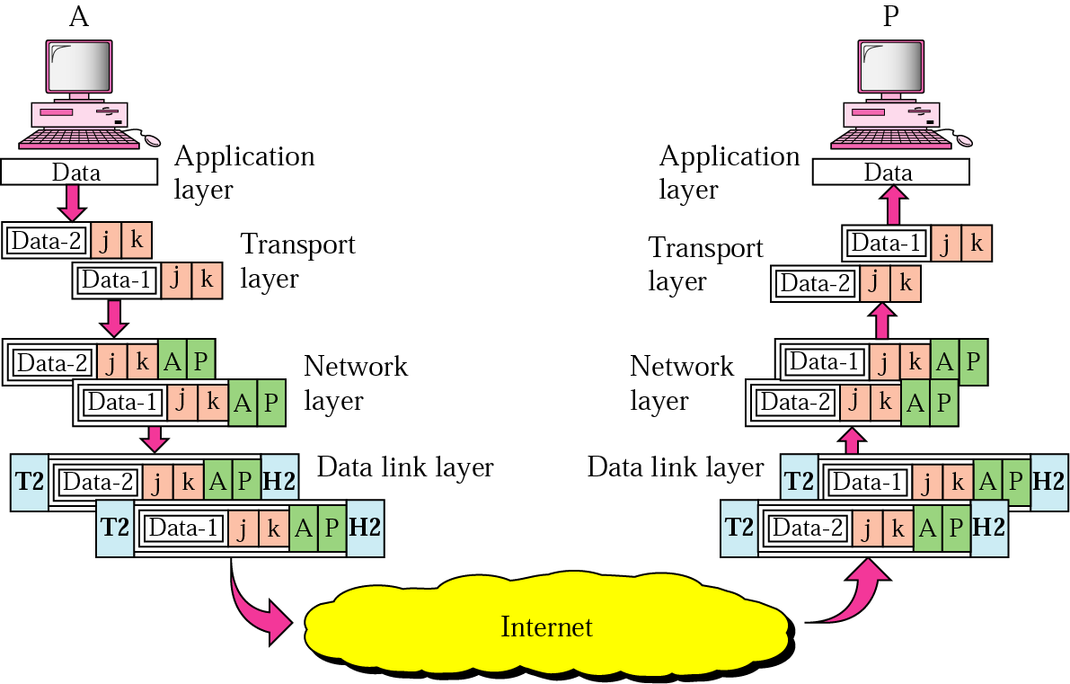
Example 3 Figure

Slide 38
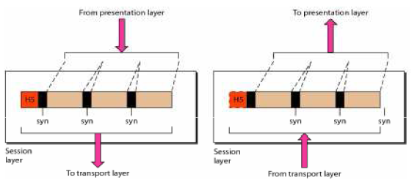
Session Layer
Note:
The session layer is responsible for dialog contol and synchronization

Slide 39
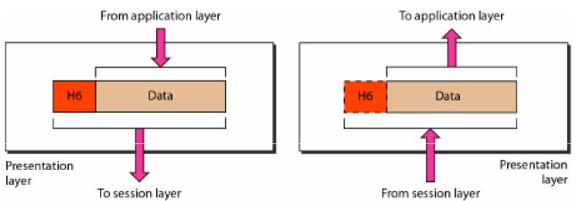
Presentation Layer
Note:
The Presentation layer is responsible for translation, compression and encryption.

Slide 40
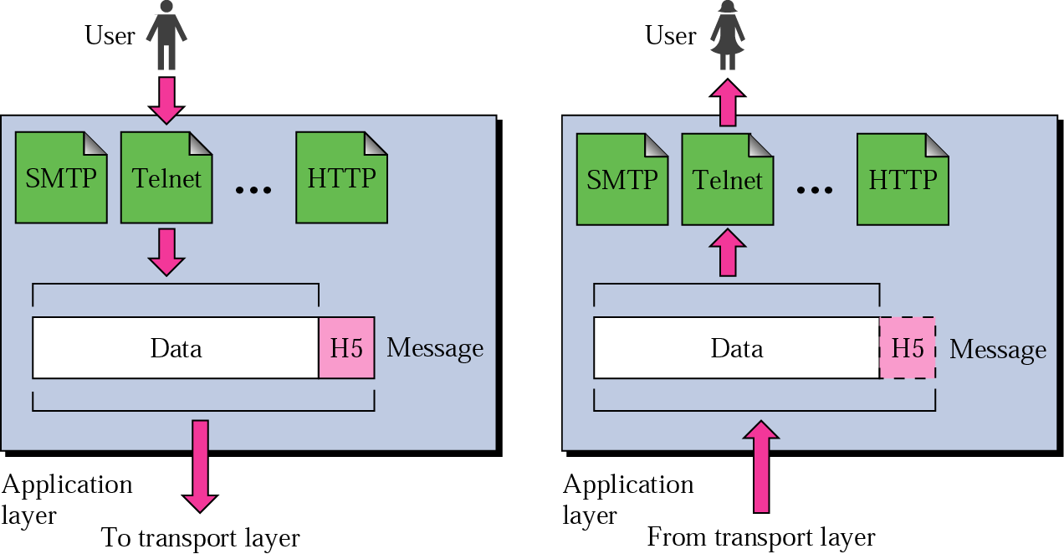
Application Layer
Note:
The application layer is responsible for providing services to the user.

Slide 41
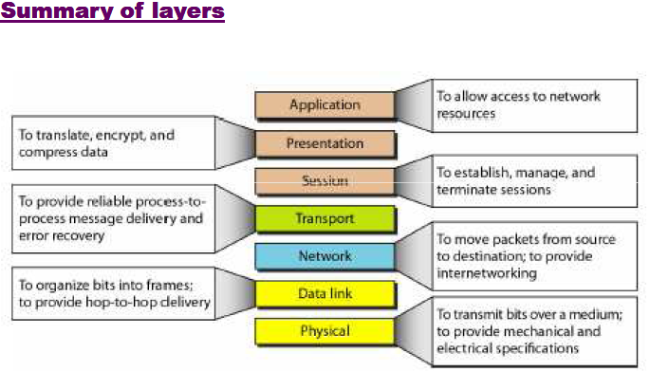

Slide 42
Examples
Layer | Example
7.) Application | HTTP, FTP, SMTP
6.) Presentation | ASCII, JPEG, PGP
5.) Session | BOOTP, NetBIOS, DHCP, DNS
4.) Transport | TCP, UDP, SPX
3.) Network | IP, IPX, ICMP
2.) Data Link | Ethernet, Token Ring, Frame Relay
1.) Physical | Bits, Interfaces, Hubs

Slide 43
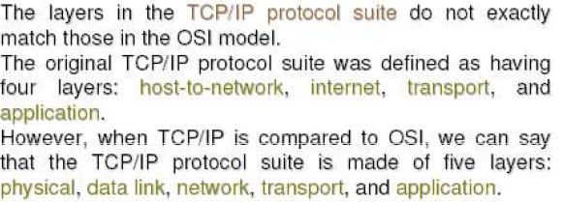
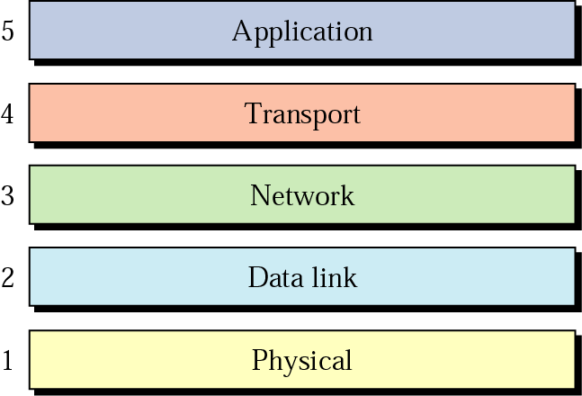
TCP/IP Protocol Suite: Internet Layer

Slide 44
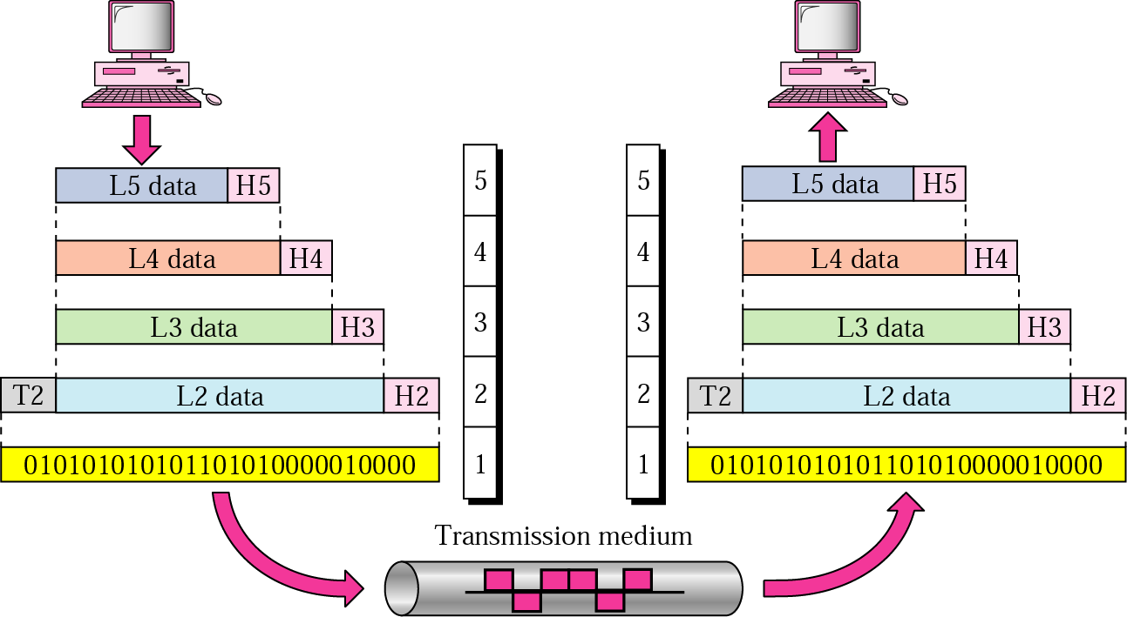
An exchange using the Internet model

Slide 45
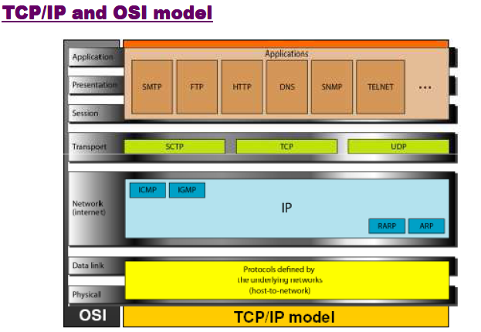

Slide 46
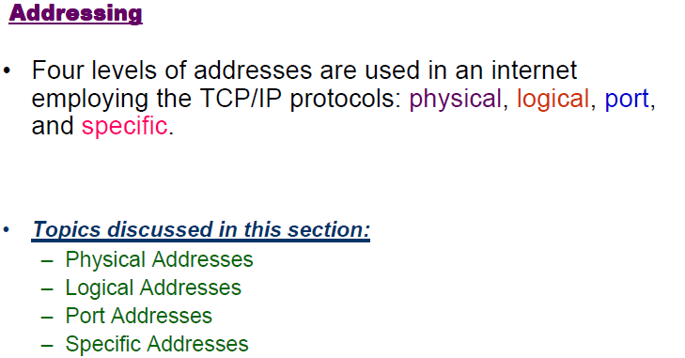

Slide 47
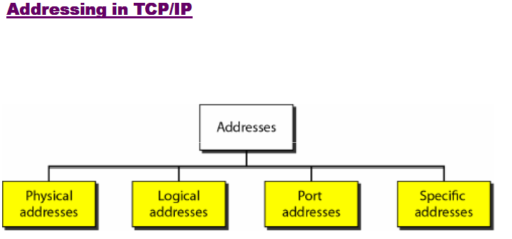

Slide 48
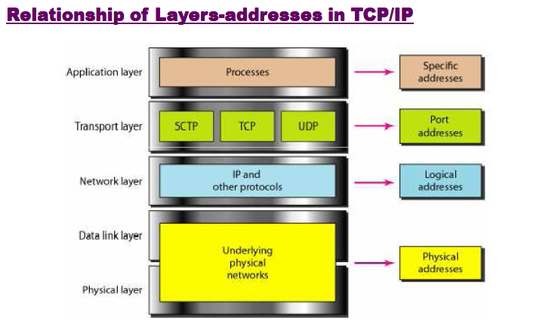

Slide 49
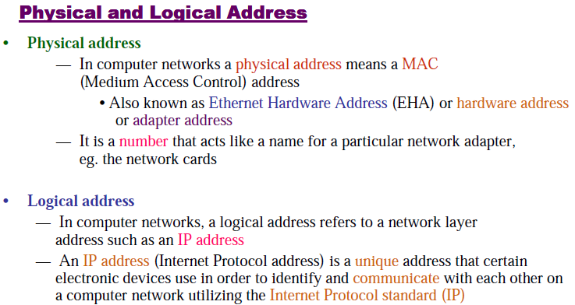

Slide 50
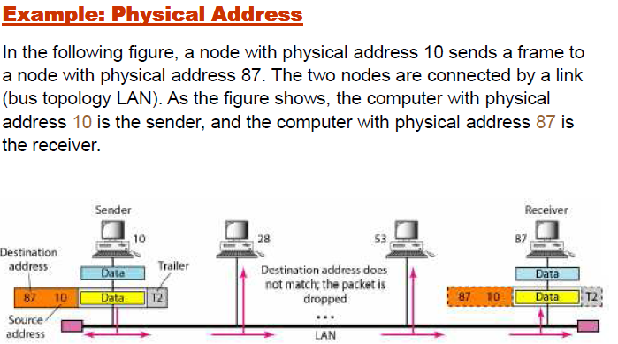

Slide 51
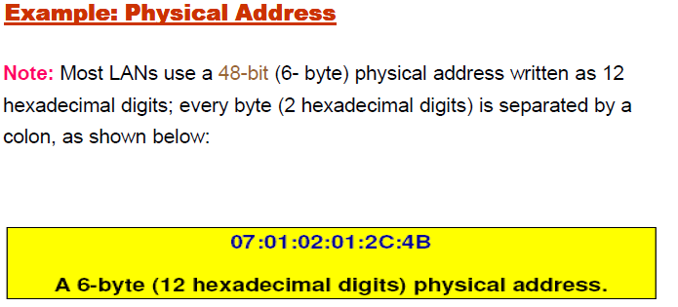

Slide 52
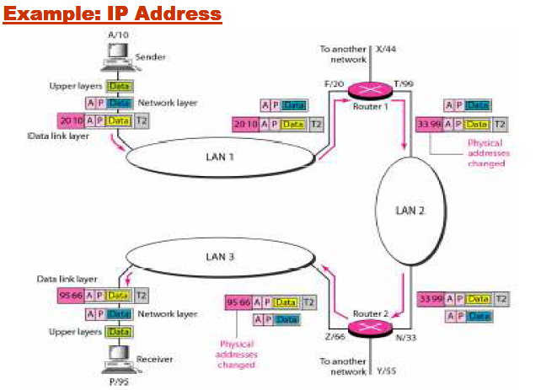

Slide 53
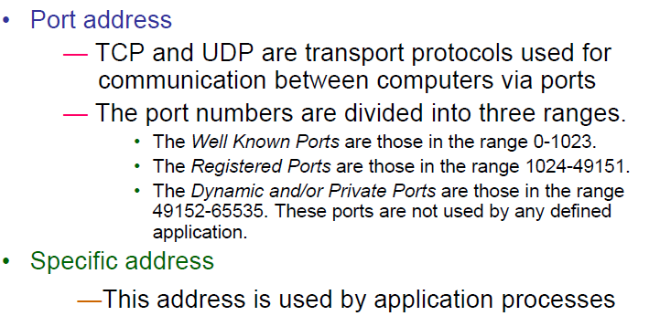

Slide 54
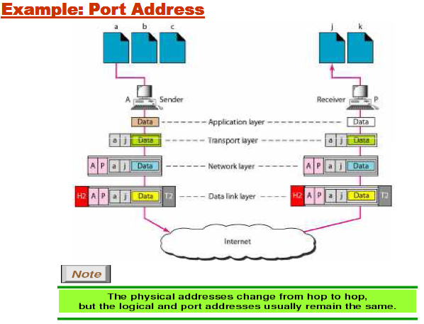

Slide 55
Thank You

